Slide 1
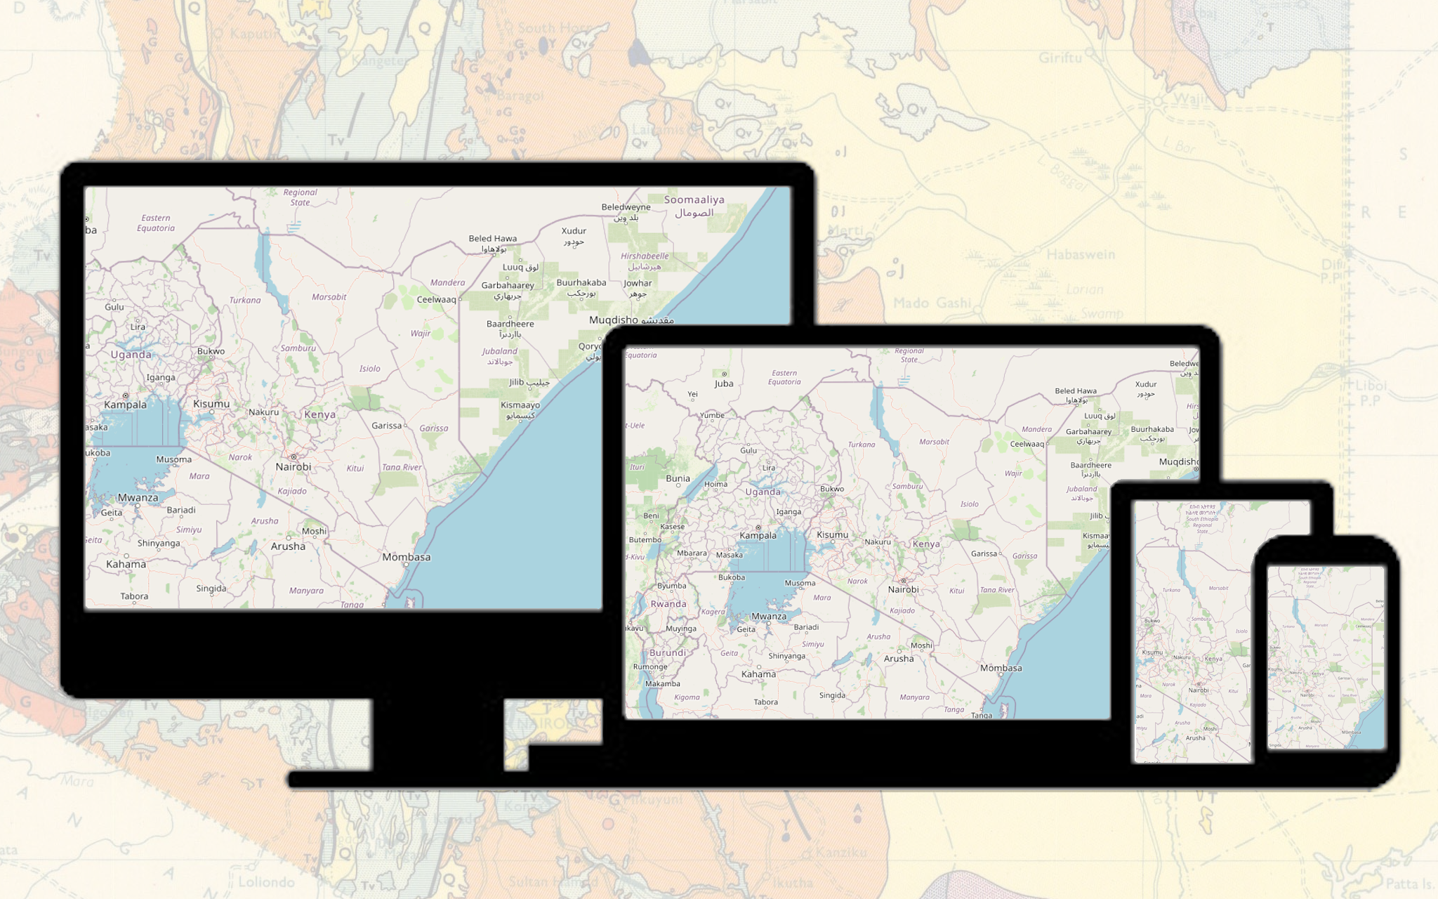
GIS Web Application Development

Slide 2
Introduction
Objectives
Understand the Fundamentals
You’ll gain a clear understanding of what GIS (Geographic Information Systems) are and their significance in modern geo applications.
Learn about opensource core technologies: Leaflet, Bootstrap, and GeoJSON and other alternertives
Setup and Environment
Get familiar with setting up a development environment for building GIS web applications.
Learn to integrate and use Leaflet, Bootstrap, and GeoJSON effectively.
Build a basic Functional Map Application
Learn to create a basic interactive map using Leaflet.
Understand how to use GeoJSON for handling geographical data.
Use Bootstrap to create a responsive and user-friendly interface.
Implement Advanced Features
Explore advanced functionalities such as dynamic data loading, custom controls, and interactive features.
Enhance the application with user interactions and customizations.
Deployment and Best Practices
Learn the steps for testing and deploying a GIS web application.
Understand best practices for maintaining and updating the application.

Slide 3
Introduction – Cont.
Overview of the Session
Introduction to GIS Web Applications
Setting Up the Environment (Visual Studio Code)
Understanding the Tools(Bootstrap, Leaflet, and GeoJSON.)
Building the Basic Map
Working with GeoJSON
Interactive Features
Advanced Features
Testing and Deployment
Q&A and Wrap-Up

Slide 4
Introduction to GIS Web Applications
Definition and Importance
GIS (Geographic Information Systems): A system designed to capture, store, manipulate, analyze, manage, and present spatial or geographic data.
Importance:
Enhances decision-making with spatial insights.
Facilitates efficient resource management.
Supports various sectors like urban planning, environmental monitoring, transportation, and disaster management.
Notes:
Highlight on different components of GIS – Hardware, software, Data, People and defined methods and process

Slide 5
Introduction to GIS Web Applications – Cont.
Real-world Applications of GIS
Urban Planning:Zoning and land-use planning.
Urban Redevelopment Authority of Singapore (URA) - https://www.ura.gov.sg/maps/index.html?service=CTRLPLAN#
Environmental Monitoring:
Tracking changes in ecosystems - https://www.climate.gov/news-features/event-tracker
Managing natural resources.
Transportation:
Route optimization. – Google Maps
Fleet Management and Realtime Tracking of vehicles. – Vehicle Tracking Software
Disaster Management:
Risk assessment and mitigation - https://www.arcgis.com/home/webmap/viewer.html?webmap=df8bcc10430f48878b01c96e907a1fc3#!
Emergency response planning
Public Health:
Disease tracking and management - https://coronavirus.jhu.edu/map.html
Health resource allocation.

Slide 6
Understanding Bootstrap
Bootstrap: An open-source front-end framework for developing responsive and mobile-first web applications. Created by Twitter, it provides a collection of CSS and JavaScript tools.
Key features for responsive design
Grid System: A flexible grid layout system that scales up to 12 columns as the device or viewport size increases.
Responsive Utilities: Classes to show or hide content based on the device's screen size.
Pre-designed Components: Ready-to-use elements like navigation bars, buttons, forms, and modals that are fully responsive.
Consistent Design: Ensures a consistent look and feel across different browsers and devices.
Bootstrap Latest Version
https://getbootstrap.com/docs/5.2/getting-started/introduction/
Notes:
Interactive Elements: Consider a brief coding demonstration to show how easy it is to create a responsive layout with Bootstrap.

Slide 7
Understanding Leaflet
Leaflet: An open-source JavaScript library used to build interactive maps for web applications. Lightweight and mobile-friendly, it is widely used for creating dynamic mapping solutions.
https://leafletjs.com/
Features and advantages.
Simplicity and Ease of Use: Easy to learn and implement with straightforward syntax and documentation.
Lightweight: Compact size ensures fast loading times and better performance.
Extensibility: Supports numerous plugins that extend its functionality, such as heatmaps, geocoding, and drawing tools.
Customization: Allows for extensive customization of map features, including markers, popups, and layers.
Mobile-Friendly: Designed with mobile responsiveness in mind, ensuring maps work well on all devices.
Integration: Seamlessly integrates with other libraries and frameworks, including GeoJSON, Bootstrap, and various mapping APIs.
Examples of projects using Leaflet.
Wikimedia Maps: Provides interactive maps for Wikipedia articles and other Wikimedia projects using Leaflet(https://maps.wikimedia.org/#4/40.75/-73.96).
Mapbox Studio: A platform for designing custom maps, leveraging Leaflet for interactive map functionality.

Slide 8
Understanding GeoJSON
GeoJSON: A format for encoding a variety of geographic data structures using JavaScript Object Notation (JSON). It is commonly used for representing simple geographical features, along with their non-spatial attributes.
https://en.wikipedia.org/wiki/GeoJSON
Structure of GeoJSON
Feature Collection: An array of Feature objects.
Feature: Contains a geometry object and properties.
Geometry Objects: Point, LineString, Polygon, MultiPoint, MultiLineString, MultiPolygon, and GeometryCollection.
https://geojson.io/

Slide 9
Understanding GeoJSON – Cont.
Use Cases
Interactive Maps:
Displaying points of interest, routes, and regions.
Data Visualization:
Visualizing geospatial data such as population density, weather patterns, or election results.
Web Mapping Services:
Used in web mapping libraries like Leaflet to add data layers.
APIs and Data Interchange:
Commonly used in APIs for sharing geospatial data between servers and clients.
Geospatial Analysis:
Analyzing spatial data for trends and patterns.

Slide 10
Setting Up the Environment
Required tools and libraries.
Code Editor:
Recommended: Visual Studio Code (VSCode).
Web Browser:
Recommended: Google Chrome or Firefox.
Libraries:
Leaflet:
Leaflet.js and Leaflet.css files.
Bootstrap:
Bootstrap CSS and JS files.
GeoJSON Data:
Sample GeoJSON data files.
Setting up a basic HTML template.
Integrating Leaflet and Bootstrap.

Slide 11
Integrating Bootstrap and Leaflet
Designing the layout with Bootstrap.
The tutorial for this is available a: https://kengeospatialist.github.io/Web-Mapping/
Integrating map with Bootstrap components.
Adding tile layers

Slide 12
Adding Markers and Popups
Creating markers.
Adding popups.
Customizing markers and popups.
The tutorial for this is available a: https://kengeospatialist.github.io/Web-Mapping/

Slide 13
Working with GeoJSON Data
Understanding GeoJSON structure.
Loading GeoJSON data.
Styling GeoJSON layers.
The tutorial for this is available a: https://kengeospatialist.github.io/Web-Mapping/

Slide 14
User Interaction
Handling map events.
Interactive layers and controls.
The tutorial for this is available a: https://kengeospatialist.github.io/Web-Mapping/

Slide 15
Example Project
The tutorial for this is available a: https://kengeospatialist.github.io/Web-Mapping/

Slide 16
Q&A
Open floor for questions.

